Slide 1
Github project
MADE BY TEAM:
Мъдрите тигри

Slide 2

Who are we?
Name | Role
Ivan Ivanov – X B ITIvanov@codingburgas.bg | Scrum Trainer
Viktor Velizarov – X A VVVelizarov18@codingburgas.bg | Developer
Krasiyana Kamburova – X B KSKamburova18@codingburgas.bg | Content creator
Petar Petkov – X G PGPetkov18@codingburgas.bg | Code Check
Stefan Diomov – X G SGDiomov18@codingburgas.bg | Content creator

Slide 3

About the project
Our program is designed to make your work in mathematics easier. The user enters sets into the program, and it can find their difference, cross section, union, and symmetrical difference. The program saves you a lot of time working with sets.

Slide 4
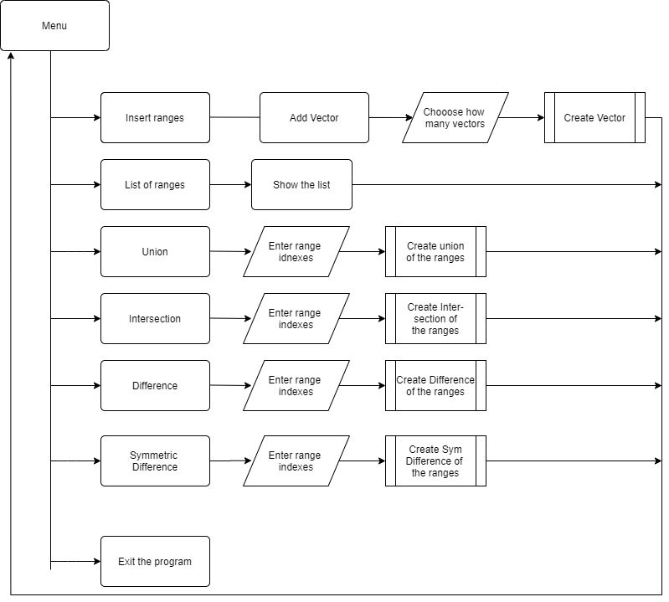
Logical scheme of our program

Slide 5



Used technologies

Slide 6


Future improvements
Add more reports to the reports menu
Translate the menus in different languages
Optimize the code so it loads faster

Slide 7

Thank you for your attention

